Slide 1
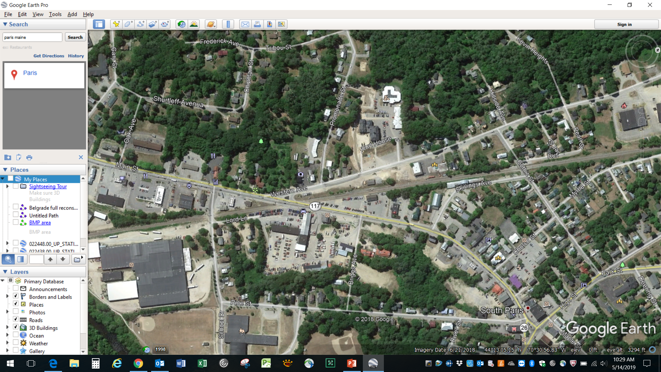
Detour Direction
Light Towers
Detour approach/arrow signs
Flaggers
Blockades

Slide 2
